Slide 1
Local Authority Briefing
Education Performance and Inclusion
November 2017

Slide 2
National and Local Updates

Slide 3
Ofsted

Slide 4
Ofsted inspections in Gloucestershire
19 inspections since 1st September 2017
A significant number of schools judged by Ofsted to be “Good” since 2012 have not been inspected for 3 years
Safeguarding
Subject inspections
HMI monitoring visits

Slide 5
Ofsted updates
Short inspections – Consultation – 2 day inspections
Inspectors should continue to treat data from teacher assessments at the end of KS2 with caution.
Inspectors will use “meaningful data” to inform areas for investigation. They will not focus on single measures with small cohorts.
Analyse School Performance (ASP) and other systems are being developed and used in schools.
Ofsted - clarification points for schools.
Ofsted Strategy 2017 – 22.

Slide 6
Ofsted Experience
Gloucestershire Schools

Slide 7
Governance

Slide 8


Slide 9
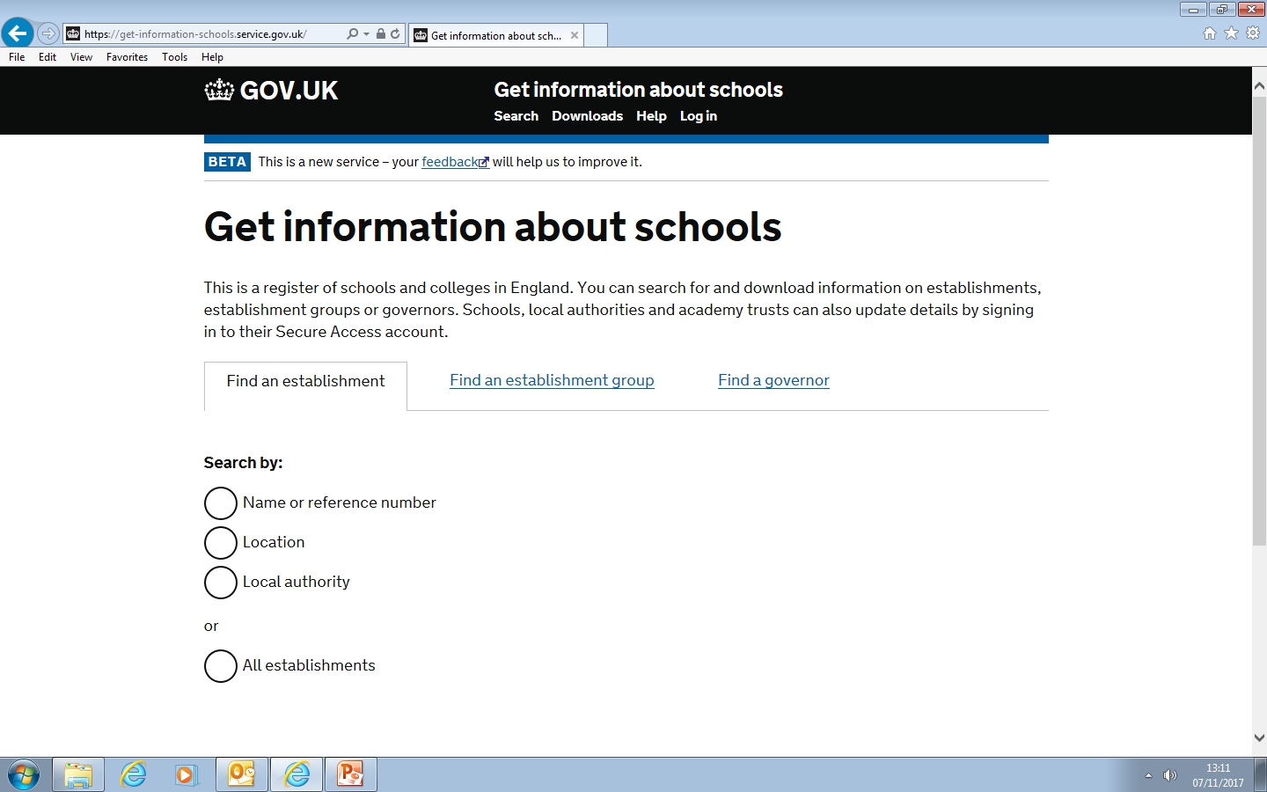
Edubase is now GIAS

Slide 10
Governor training

Slide 11
GDPR General Data Protection Regulation
Ensuring that your school community is on track for the GDPR
Thursday 7th December 2017, 9.30 – 12.00
Shire Hall, Westgate Street, Gloucester GL1 2TG
£75.00 per school (maximum of 2 places) – first come, first served
To book, email: foi@gloucestershire.gov.uk

Slide 12
Early Years

Slide 13

2017 EYFSP Headlines

Slide 14
EYFSP Outcomes 2013-14
National GLD | Gloucestershire GLD
Good Level of Development 71% (up 2% from 69% last year) | Good Level of Development 68% (up 1% from 67% last year)
34.5. The average EYFPS point score for 2017. No change from 34.5 in 2016. | 35.1. The average EYFPS point score for 2017. A decrease of 0.1 points from 35.2 in 2016.
69%. The proportion of children achieving at least the expected level in all 17 early learning goals | 67%. The proportion of children achieving at least the expected level in all 17 early learning goals
13.7%. The gender gap between the percentage of girls and boys achieving a good level of development - 77.7% of girls achieved a GLD compared to 64.0%% of boys | 12.9%. The gender gap between the percentage of girls and boys achieving a good level of development - 74.9% of girls achieved a GLD compared to 62.0% of boys
The achievement gap between the lowest attaining 20% of children and the mean average was 31.7%. The achievement gap has increased by 0.3% from 31.4% in 2016. | The achievement gap between the lowest attaining 20% of children and the mean average was 30.4%. The achievement gap has decreased by 0.5% from 30.9% in 2016.
Early Years Foundation Stage Profile Results 2017
Please note that the rounding up and down has a slight influence of the figures.
Notes:
Good level of development expected or above in the prime areas (CL PD PSED) and Literacy and Mathematical development i.e. 12 out of the 17 judgements

Slide 15
Detail behind the headlines …
 | 2013 | 2014 | 2015 | 2016 | 2017
Reading | 74.7% (70.5% national) | 75.4% (73.9% national) | 79.2% (76.1% national) | 78.5% (77.0% national) | 77.9% (77.0% national)
Writing | 65.5% (61.9% national) | 65.8% (67.0% national) | 71.1% (70.8% national) | 71.8% (72.6% national) | 71.8% (73.3% national)
Numbers | 69.5% (68.5% national) | 71.6% (74.2% national) | 77.0% (77.4% national) | 77.5% (78.8% national) | 78.6% (79.2% national)
Space, Shape and Measure | 79.6% (75.1% national) | 80.0% (78.7% national) | 83.8% (80.8% national) | 83.0% (81.7% national) | 83.7% (81.6% national)
Notes:
Red indicates worse than National however it may still be better than the previous year in Gloucestershire
How does this compare to your schools results – what are the trends year on year in your school?

Slide 16
Notes:
Some children missed out on getting the Good Level of Development by 1 ELG. That is they were at expected or exceeding in 11 out of the required 12 ELG’s - they missed out by 1. Data analysis shows us which was the most commonly missed goal and we can also look at this by gender.
So what ?
Review your own data –be clear which ELG’s were missed if a child failed to reach a Good Level of Development. Plan actions to improve attainment in ELG’s which where attainment was lower than expected
Recommend that as the year progresses you keep an eye on the attainment of the crucial 12 ELG’s for each child so that you can specifically target ELG’S where attainment is likely to be lower than expected
Review carefully the provision you have for developing writing opportunities that meet the individual needs of your cohort of children
Of the children who missed GLD by 1 ELG just over 55 % of boys missed it by failing to get expected or above in writing and this is mirrored for girls where those that missed the GLD by failing to get the writing ELG was just under 45%
So what ? Recommend that as the year progresses you keep an eye on the attainment of the 12 for each child so that you can specifically target ELG’S . Review carefully the provision you have for independent writing opportunities, consider how often you model writing

Slide 17
Primary Assessment consultation response (September 2017)
Baseline assessment
Early Years Foundation Stage Profile
Moderation
Changes for 2020/21 academic year.

Slide 18
Reception Baseline
Develop a new single supplier baseline as a statutory assessment, test and evaluate it so that it is ready for introduction in reception by autumn 2020.
Focus on skills which can be reliably assessed and which correlate with attainment in English and mathematics at the end of key stage 2, most notably early literacy and numeracy.
Conduct a large-scale pilot and evaluation in 2019/20.

Slide 19
The new baseline will not be an observational assessment which is carried out over time, like the EYFSP.
It will be completed in the first half-term.
The assessment will include a narrative summary of the pupil’s strengths and weaknesses to inform teaching.
The new reception baseline will only be used seven years later to make the progress measure at the end of primary school.
Notes:
They would not be used to judge, label, or track individual pupil progress, to set targets for them to reach, to ‘predict’ the key stage 2 results of individual pupils, or assume that they make linear progress. Furthermore, the data would not be used in any way to measure performance in early years or to hold early years practitioners to account. Ofsted will continue to look at EYFSP information as a rounded judgement of child development
In the consultation we set out that if a new baseline assessment were introduced, it would be 7 years after its introduction until the first reception to key stage 2 progress measure could be produced. In the meantime, we proposed continuing to use key stage 1 teacher assessment data as the baseline for pupils who will be completing primary school before that time.

Slide 20
Early Years Foundation Stage Profile
The 7 areas of learning and development will remain unchanged.
The number of ELGs underpinning the framework will also remain unchanged.
Limiting end of the year assessment to the 3 prime areas (communication and language development, physical development and personal, social and emotional development) and the specific areas of mathematics and literacy will be explored further (GLD).
Notes:
we will continue to work with experts and practitioners and assess the latest child development evidence, with the aim of ensuring that all descriptors are clear and focused on the right age-appropriate outcomes.

Slide 21
The descriptors for a typical level of development against the ELGs will be made clearer and revised.
ELGs will be more appropriately aligned with the Year 1 curriculum, particularly the ELGs for literacy and mathematics.
The teaching of literacy and numeracy in the early years will be strengthened.
Notes:
We believe that the ELGs in need of the most significant revisions are those relating to the following areas:
• Communication and language: we will revise the communication and language ELGs to ensure that there is sufficient focus on increasing depth and breadth of vocabulary.
• Physical development: we will ensure that there is sufficient focus on both fine and gross motor skills, given the research evidence around links between physical activity and cognitive development.
• Personal, social and emotional development: we will bring the PSED ELGs into line with the latest evidence on self-regulation and executive functioning, given the evidence that it is a predictor of future attainment.
• Mathematics and literacy: we will review and revise the mathematics and literacy ELGs to ensure that they support children to develop the right building blocks for learning at key stage 1.
• We will also refine and clarify the ELGs in understanding the world and expressive arts and design, and bring these up to date with the evidence on child development.
ELGs should be better aligned with expectations at key stage 1, particularly mathematics and literacy. A common theme emerging from the consultation was that teaching approaches for mathematics and literacy ELGs could be in conflict with the methods taught in year 1. We heard that this is particularly the case regarding the use of numbers and phonics, and that more could be done to frame the descriptors and supporting guidance in order to ensure that pupils are best prepared for key stage 1. We also heard a significant number of requests to include vocabulary as a key descriptor in the communication and language ELGs, given the substantial research evidence to support it as a predictor of future attainment.

Slide 22
The existing assessment scales: ‘emerging’, ‘expected’ and ‘exceeding’ will be retained.
A review will consider whether it is right to introduce an additional band within the ‘emerging’ scale.
descriptors underpinning ‘exceeding’ will be clarified.

Slide 23
The same scale approach for children with SEND will be retained, but ways in which reception teachers can share more nuanced information with Year 1 teachers and parents about individual progress and future development needs will be explored.
All guidance for administering the EYFSP is in scope for revision including the EYFS profile handbook and supporting exemplification materials.

Slide 24
The requirements for evidence and how this should be collected and shared will be clarified dispelling myths that have emerged over time.
The wider use of online tools to collect and share evidence will be shared.
Notes:
The purpose of the EYFSP has never been to hold individual schools to account for their performance and this will not change. The EYFSP will continue to assess each child’s individual progress and development throughout the reception year. It will give a year 1 teacher accurate information about which individual children will need more attention in specific areas of learning as they move through key stage 1. The EYFSP will continue to provide national data to government and local authorities, to provide a picture of provision across the country.

Slide 25
Moderation of the EYFSP
Alternative models to local authority-led moderation, such as moderating within school clusters, will be investigated to reduce burdens without compromising the rigour of the moderation process.
The possibility of moderating a limited number of ELGs will be explored.
Guidance relating to the moderation of the EYFSP will be reviewed and myths dispelled.
Notes:
There was a broad consensus for retaining both internal and external moderation processes. However, many of the same respondents felt that the moderation process should be improved. The ways in which this could be done included formal training, and clear and concise guidance with examples of effective moderation practices. Gloucestershire’s model of Moderation has been praised by Dfe and includes both formal training and hands on moderation practice

Slide 26

Gloucestershire Moderation 2018
25% of schools receive a moderation visit annually, which scrutinises all 17 ELGs.
In addition some schools with NQTs, new HTs, data issues last year.
All schools will be notified in January.
Notes:
This process will continue as in previous years

Slide 27
School EYFSP preparation
All schools should:
Access the Gloucestershire Moderation Plan.
Schools being moderated should:
Ensure the email informing the school has been passed on to the teacher(s).
Make interim judgements in May against each of the 17 ELGs.
Identify teachers new to moderation who may benefit from the training.
Notes:
You should hear in January if you will be moderated. Please let EYFS teachers know as soon as you do, it is helpful at the Moderation workshops for us to discuss details of the forthcoming visits and CT’s can ask us questions that they may have.
Glos LA Training:
Moderation workshops throughout the county in February/March – all schools able to attend - 1 per setting
Dispelling the Myths of Moderation for teachers new to the process in April
Both courses will be advertised in Spring Early Years Team training brochure

Slide 28
Evidence for the Profile
Evidence doesn’t need to be formally recorded or documented.
Paperwork should be kept to the minimum that the practitioner requires to illustrate, support and recall their knowledge of the child’s attainment.
Notes:
this information is in the Statutory Framework for the EYFS Pg 13 para 2.2

Slide 29
Additional Information
Useful websites:
www.foundationyears.org.uk
www.gloucestershire.gov.uk/earlyyearsteam
Email:
earlyyearsteam@gloucestershire.gov.uk
julia.hawkes@gloucestershire.gov.uk

Slide 30
NQTs Please see handout
Notes:
There are no slides

Slide 31
Attendance

Slide 32
Headteacher Responsibilities
Statutory Responsibilities
keeping of registers for both sessions of the school day - accurate coding and recording
authorising absences
reporting to the LA (safeguarding)
- deletions from the register
- 10+ days continuous unauthorised absence
- part-time timetables (currently non-statutory but included within KCSiE September 2016)
Notes:
These are all reminders of key statutory Headteacher responsibilities regarding attendance.
Detailed information is contained within the new GCC attendance guidance document for schools available electronically on schoolsnet under the ‘your pupils’ section
Key reporting requirements, which link into safeguarding - there is an explanatory slide for each requirement:
-deletions from the register (statutory)
-10+ days continuous unauthorised absence (statutory)
-part-time timetables (currently non-statutory but included within KCSiE Sept2016 as recommended practice- schools would need to be able to justify why they do not inform the LA)

Slide 33
Safeguarding: Improving identification of children missing education
Statutory Regulations September 2016
Schools will:
Inform their LA when they are about to delete a pupil’s name from the admission register under all 15 grounds (previously 5)
Record details of the pupil’s residence, name of the person with whom they will reside, date from which they will reside there and the name of the destination school (where they can reasonably obtain this information)
Inform their LA of the pupil’s destination school and the home address if the pupil is moving to a new school
Provide information to their LA when registering new pupils within five days including the pupil’s address and previous school (where they can reasonably obtain this information)
Notes:
The slide should serve as a reminder- it does not need to be listed in detail- covers us an LA re safeguarding reminders to schools statutory duties.
Reminder: Deletions from registers:
Information regarding this has been shared at attendance networks and on Heads up/Whats up Gov since it came into force in Sept 2016.
Detailed information is contained within the new GCC attendance guidance document for schools available electronically on schoolsnet under the ‘your pupils’ section

Slide 34
Safeguarding of pupils with 10+ days unauthorised absence
DfE statutory guidance: ‘Keeping children safe in education’ Sept 2016 (Annex A) states that:
“ all schools and academies must inform the local authority of any pupil who… has been absent without the school’s permission for a continuous period of 10 school days or more”
Schoolsnet: Attendance: ‘Pupils recorded with 10+ days of continuous unauthorised absence’ duty to report
If you have any pupils who meet this criteria, please inform the LA as soon as possible to ensure that your school is meeting safeguarding responsibilities
Notes:
The slide should serve as a reminder- it does not need to be listed in detail- covers us an LA re safeguarding reminders to schools statutory duties.
A further reminder to all HTs of their responsibility to inform the LA of any pupils with 10+ days of continuously unauthorised absence.
In addition, if a child has regular incidences of unauthorised absence and the school is concerned that it is unable to communicate effectively with parents, then these children and actions taken by the school could be discussed with the school’s named inclusion adviser.
Detailed information is contained within the new GCC attendance guidance document for schools available electronically on schoolsnet under the ‘your pupils’ section

Slide 35
Safeguarding of pupils: part-time timetables
The Ofsted document ‘Pupils Missing Out on Education’ (November 2013) and DfE ‘Keeping Children Safe in Education’ (2016) states that:
"the LA should establish a central record of all children not accessing school in the usual way ...schools should inform the LA of any part-time education arrangement regardless of the type of school – ie maintained school, academy or free school”
Throughout the school year, if you have any pupils who meet this criteria, please complete the proforma on Schoolsnet as soon as possible and send to the named email address to ensure that safeguarding responsibilities are being met.
Notes:
A further reminder to all HTs of their responsibility to inform the LA of any pupils who are currently attending the school on a part-time basis.
Detailed information is contained within the new GCC attendance guidance document for schools available electronically on schoolsnet under the ‘your pupils’ section
Please inform the LA using the spreadsheet on schoolsnet as soon as the arrangement is made. A reminder that this arrangement should always be time-limited with secure justification for it’s requirement eg health related.
All schools will be asked to make a nil return, (if appropriate), on a termly basis in order that safeguarding responsibilities are met for all children and young people.
It is crucial that all pupils across the county, regardless of where they access their education are offered appropriate and sufficient educational provision .

Slide 36
Attendance Data Update:
Terms 1-4 (2016/17)
Primary Schools
www.gov.uk/government/statistics/pupil-absence-in-schools-in-england-autumn-2016-and-spring-2017
Notes:
This data was released by the DfE on 19/10/17.
See link for statistical first release from the DfE. The full document was shared at recent attendance network events and is also available on schoolsnet in GlosED attendance network resources.

Slide 37
Key data headlines
Overall attendance and Persistent Absence (PA) rates
Notes:
For the primary attendance rate in Autumn and Spring terms 2016/17, Gloucestershire ranked 67th amongst all England Local Authorities and 5th amongst south west Las.
As previously, Gloucestershire Primary Schools are slightly above national figures. Attendance data overall has remained stable for the last 2 years.

Slide 38
Notes:
3 year trend for Autumn and Spring terms, (Terms 1-4) across Primary schools in Glos LA and in England
Glos LA Primary schools overall absence is in-line with national.
Glos LA Primary schools have less persistent absentees (PA) in comparison to all other schools in England

Slide 39
Notes:
Analysis of coding for reasons for absence in Glos LA Primary Schools in comparison to Primary Schools in England.
Key fact, in Glos LA, we have more absence coded as illness than across England nationally. Is that really because more of our children are ill than nationally or is there another reason? Eg resilience of pupils, challenge to parents when they state that their child is unwell ?
Does your school analyse its’ attendance data by coding and then implement appropriate strategies/interventions to try to overcome any disproportionate reasons? Does your school look at the attendance of vulnerable groups in comparison to the non-vulnerable group eg SEN v NonSEN and in comparison to national data for each vulnerable group in comparison to their peers ?

Slide 40
Gloucestershire County Council Securing Regular and Punctual Attendance Guidance for Schools
Notes:
GCC has produced revised guidance for schools:
Securing Regular and Punctual Attendance
This was shared at the recent attendance network events and is also available on schoolsnet in the ‘your pupils’ attendance section.
It contains lots of useful, key information- alert Ht’s to the need to ensure their attendance policy is revised to reflect the fact that regular attendance should mean that all pupils, are in school all of the time, unless the reason for their absence is one which meets the school’s criteria for authorising absences. Schools should not state in their policies that pupils should aim to be in school 97% of the time etc.. This is an overall school attendance target, not a target for all individual pupils because it can make it difficult in the courts when working with schools who request legal proceedings.
Suggested statement is contained in this new GCC guidance for schools. Schools can also ask their allocated IA.

Slide 41
Gloucestershire County Council
Penalty Notice Code of Conduct for Schools
Notes:
Also included in the GCC guidance for schools: Securing Regular and Punctual Attendance is a revised Code of Conduct for Issuing Penalty Notices.
The key change is regarding a sharpening of practice in schools being able to request PN’s for unauthorised holiday absence, without the need for issuing a warning letter- as long as the school can demonstrate that through their general communications with parents eg attendance policy, newsletter, forms for parents to request holidays/leave of absence, letters home, parent information evenings etc..
Once again, this has been made clear in the GCC guidance doc and was circulated in Heads up and shared at recent Attendance networks.
Schools are reminded to ask their allocated IA for any clarification required or email queries to attendance@gloucestershire.gov.uk

Slide 42
Please contact your Local Authority allocated Inclusion Adviser from the EPI Team with any attendance concerns or send an email to attendance@gloucestershire.gov.uk

Slide 43
Curriculum

Slide 44
Curriculum: intent, implementation and impact
Ofsted: review of the curriculum. October 2017 preliminary findings in Amanda Spielman’s monthly commentary.
Development work for the new inspection framework
Sean Harford HMI
National Director, Education
June 2017 Conference

Slide 45
Ofsted: Curriculum Review (primary and secondary schools) Amanda Spielman Chief HMI Ofsted
Monthly commentary 11th October 2017
Link to Ofsted: Monthly commentary
‘What do we understand to be the real substance of education? When we think about what the core purpose of education is, what comes first to our minds? In recent years, we have thought a great deal about the role of leaders and the importance of teaching. We have also given a great deal of our collective time to exam grades and progress measures. These are undoubtedly important. However, at the very heart of education sits the vast accumulated wealth of human knowledge and what we choose to impart to the next generation: the curriculum.’

Slide 46
Amanda Spielman (11.10.17)
‘The first phase of the review has included:
research visits to 40 schools
review of routine school inspection reports
focus group discussions in 5 regions with headteachers of good and outstanding schools
questionnaire responses from Ofsted’s Parent Panel
desk-based retrieval from school websites’
‘We deliberately approached this first phase in an open-ended and exploratory way so as not to prematurely close down areas of interest. We are using the initial findings and patterns from the emerging data in this phase to develop questions that are more focused. These questions will be explored further in phase two.’
Notes:
Handout extract

Slide 47

GlosEd Leaders
Teachers with experience and expertise can become GlosEd Leaders.
Your school may be looking to use one of our GlosEd Leaders to support you in improving/enhancing provision in your school.
For all information on GlosEd Leaders please share this link:
Gloucestershire Schoolsnet: GlosEd Leaders

Slide 48


Online Pupil Survey 2018
The Online Pupil Survey (OPS) – the 12th since 2006 – will be live for schools and colleges to access for 10 weeks from mid January until the end of March 2018. If you would like to take part, please sign up by the 30th November 2017 by visiting: https://gccopsmonitor.fabsurveys.co.uk/SchoolsAdmin/SchoolSignUpForm
or speak to your Gloucestershire Healthy Living & Learning (GHLL) Lead Teacher.

Slide 49

OPS Lodeseeker Training
Our online data reporting and visualisation tool, Lodeseeker™, is a tool through which schools can: access their OPS, target areas of improvement; demonstrate to OFSTED how they are actively monitoring performance and listening to Pupil Voice.
We have made significant improvements to Lodeseeker™ with a new summary dashboard and different reports, from comparison with County overviews to detailed drill-downs and, from current behaviours to longitudinal trends.
The twilight training session will give you the confidence to make the most of this valuable resource and is an opportunity to explore your data with expert support.
.

Slide 50
GHLL has 3 sessions available
Date | Time | Venue
Tuesday 28th November | 4.30-6.00pm | Marling School, Cainscross Road, Stroud, GL5 4HE
Wednesday 29th November | 4.30-6.00pm | Tewkesbury School, Ashchurch Road, Tewkesbury, GL208DF
Tuesday 5th December | 4.30-6.00pm | Barnwood Park School, St Lawrence Road, Gloucester, GL4 3QU
To book please use: https://gccopsmonitor.fabsurveys.co.uk/SchoolsAdmin/EventSignUp
or contact: ghll@gloucestershire.gov.uk

Slide 51


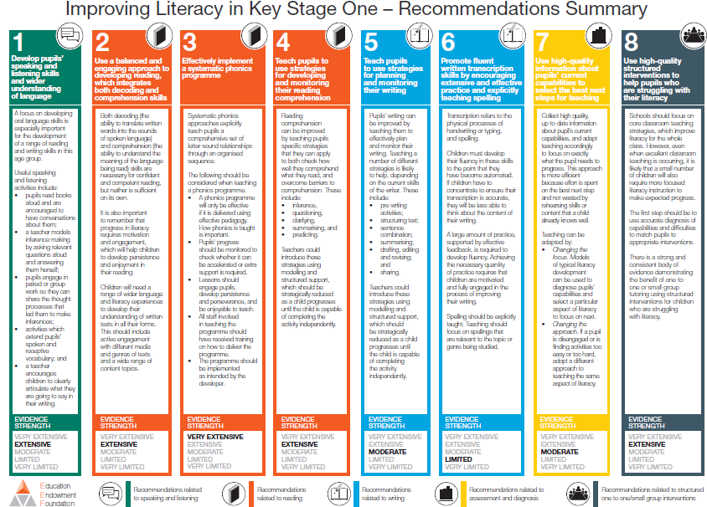
Education Endowment Foundation Update
Oct ‘17: ‘Early Language Development’
2107: KS1 ‘Self-assessment guide’ to accompany ‘Key Stage 1 Improving Literacy’
KS2: similar assessment guide under development
Autumn 2017: EYFS document due
Research evidence and resources at www.educationendowmentfoundation.org.uk
Notes:
Reminder about the KS1 and KS2 documents – provided at the June meeting. Refer to KS1 Literacy project: 16 schools plus 4 schools facilitating clusters. Led by EEF research school lead. Extremely positive feedback from delegates attending.

Slide 52
Gloucestershire 2017-18 Key Stage 1 Improving Literacy Project
The LA is facilitating a development opportunity for 20 Key Stage 1 teachers/English leads to work with an Education Endowment Foundation (EEF) Research School.
The programme has been designed to meet the needs of Gloucestershire schools and is based around the eight practical recommendations in EEF’s ‘Improving Literacy in Key Stage One’ Guidance Report.
Project Lead: Megan Dixon, Director of Literacy for The Aspire Educational Trust and Director of Research and Development for the Aspirer Teaching Alliance - an EEF Research School.
The first meeting took place in November. There are four remaining meetings. The last meeting will be an opportunity for schools to share their practice.

Slide 53

Improving Maths in KS2 and KS3 (EEF, November 2017)
Focus: the teaching of mathematics to pupils in KS2 (and KS3).
Eight practical, evidence-based recommendations relevant to all pupils, but particularly to those who struggle with aspects of their learning.
SUMMARY OF RECOMMENDATIONS
Use assessment to build on pupils’ existing knowledge and understanding.
Use manipulatives and representations.
Teach strategies for solving problems.
Enable pupils to develop a rich network of mathematical knowledge.
Develop pupils’ independence and motivation.
Use tasks and resources to challenge and support pupils’ mathematics.
Use structured interventions to provide additional support.
Support pupils to make a successful transition between primary and secondary school.

Slide 54
Assessment

Slide 55
2017 KS1 and KS2
Assessment Information (Provisional)
Statistics: EYFS profile
https://www.gov.uk/government/collections/statistics-early-years-foundation-stage-profile
Statistics: KS1
https://www.gov.uk/government/collections/statistics-key-stage-1
Statistics: KS2
https://www.gov.uk/government/collections/statistics-key-stage-2

Slide 56
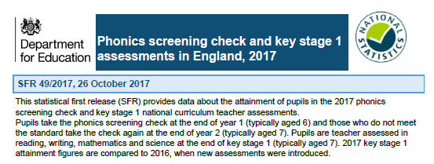
Phonics Screening Check: pupils meeting the expected standard (2012-2017)
PSC | NATIONAL (GLOS LA) |  |  | NATIONAL (GLOS LA)
 |  |  |  | Improvement:Y1-Y2 (percentage points)
 | Year 1 | End of KS1
2017 | 81% (80%) | 92% (92%) |  | 11 (11)
2016 | 81% (81%) | 91% (91%) |  | 14 (15)
2015 | 77% (76%) | 90% (91%) |  | 16 (16)
2014 | 74% (75%) | 89% (90%) |  | 20 (18)
2013 | 69% (72%) | 85% (88%) |  | 27 (27)
2012 | 58% (61%) | N/A |  | N/A
Source: DfE SFR (September 2017

Slide 57
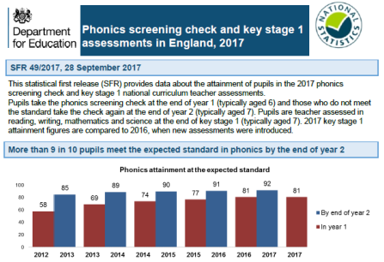
KS1 ATTAINMENT
SUBJECTS | EXS+ / GDS (Glos LA)
 | 2016 | 2017
Reading | 74% / 24% (73% / 23%) | 76% / 25% (75% / 25%)
Writing | 65% / 13% (61% / 12%) | 68% / 16% (66% / 14%)
Mathematics | 73% / 18% (69% / 15%) | 75% / 21% (74% / 18%)
Science | 82% (82%) | 83% (84%)
2017 PSC and KS1 national curriculum assessments (provisional)

Slide 58
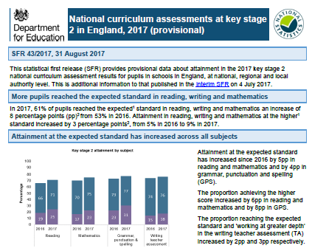
KS2 ATTAINMENT
SUBJECTS | % EXS+ / % High* or GDS* (Glos LA)
 | 2016 | 2017
Reading | 66%/19% (70%/23%) | 71%/25% (74%/29%)
Writing | 74%/15% (70%/13%) | 76%/18% (73%/17%)
Mathematics | 70%/17% (70%/18%) | 75%/23% (75%/23%)
GPS | 73%/23% (73%/24%) | 77%/31% (77%/31%)
Science | 81%/- (80%/-) | 82%/- (80%/-)
2017 KS2 national curriculum assessments
(provisional)
* ‘High’ refers to scaled score (reading, mathematics, GPS) of, at least, 110. GDS refers to writing TA only.

Slide 59

Primary School Accountability
 | 2017 (2016)
 | KS2 Attainment | KS1-KS2 Average Progress
 | EXS+ (RWM) | Reading | Writing | Maths
National | 61% (53%) | 0 (0) | 0 (0) | 0 (0)
Glos LA | 61% (54%) | +0.8 (+0.6) | -0.3 (-1.2) | +0.1 (-0.4)
Floor standard | 65% (65%) | -5 (-5) | -7 (-7) | -5 (-5)
Coasting standard | 85% (85%) | -2.5 (-2.5) | -2.5 (-3.5) | -2.5 (-2.5)
 | Reading/Writing/Mathematics (combined) EXS+ / High Standard
 | 2016 | 2017
National | 53% / 5% | 61% / 9%
Glos LA | 54% / 6% | 61% / 9%

Slide 60
The DfE has published the 2017 technical guide and other complementary documents.
The criteria for 2017 floor standard shows no change from 2016.
‘In 2017, a school will be above the floor if:
at least 65% of pupils meet the expected standard in reading, writing and mathematics; or
the school achieves sufficient progress scores in all three subjects … at least -5 in reading, -5 in mathematics and -7 in writing.
To be above the floor, the school needs to meet either the attainment or all of the progress element.’ [p5]

Slide 61
2017 KS1/KS2 DFE/STA GUIDANCE INCLUDING STATUTORY REQUIREMENTS
JULY: KS1/KS2 interim TA frameworks (updated Dec16). KS1/KS2 TA exemplification materials.
NOVEMBER
KS1/KS2 interactive webinars
NOVEMBER
Confirmation that P scales remain statutory for 2016/17
MARCH/APRIL: PSC and KS1/KS2 test administration guidance (TAG)
MARCH/APRIL: KS2 tests and PSC: monitoring visits’ guidance
JUNE
LA submission to DfE: schools selected for KS1 and KS2 writing external moderation
OCTOBER
KS1/KS2 ARA (revised Mar17)
OCTOBER
The Rochford Review: final report
NOVEMBER
STA briefing for LAs
FEBRUARY
LA national moderator training and standardisation task
MARCH
KS1 and KS2 LA external moderator training and standardisation tasks
OCTOBER
2017 KS1/KS2 assessment planners
OCTOBER
2017 KS1/KS1 TA external moderation: (schools/LAs)
JANUARY LA submission to STA: ‘2017 KS1 and KS2 TA Moderation Plans’
MARCH
STA update: ‘KS2 TA moderation: addressing misconceptions’ video
JUNE
Updated ‘P scales: attainment targets for pupils with SEN’
MAY 2017 NC tests
SEP
2016
OCT
2016
NOV
2016
DEC
2016
JAN
2017
FEB
2017
MAR
2017
APR
2017
JUN
2017
JUL
2017
SEP16-JUN17 ‘Statutory requirements for assessment’: GCC Schoolsnet and regular updates via GCC HeadsUp
OCTOBER
KS1/KS2 LA external moderator applications
JANUARY
Y2/Y6 staff audit sent to schools
MARCH
STA briefing for schools
MAY
Writing TA briefings for HTs (x6)
MAY
KS1/KS2 ‘Meet the Moderator’
MARCH
LA briefings for HTs/CoGs
MAY and JUNE
KS2/PSC monitoring visits
JANUARY and MARCH
KS1/KS2 assessment and moderation network meetings
MAY
P scale clinics (x6)
DECEMBER
KS1/KS2 LA external moderator interviews
OCTOBER
LA briefings for HTs/CoGs
MARCH and MAY
KS1/KS2 LA external moderator networks
JUNE
KS1/KS2 moderation
SEPTEMBER
Y2/Y6 staff audit sent to schools
JUNE
KS1/KS2 cluster moderation meetings (x15)
LOCAL SUPPORT

Slide 62
2017 KS1 Glos LA External Moderation
Strengths (most schools)
Teachers talked with confidence about pupil achievement.
Schools were familiar with statements/standards in the teacher assessment (TA) frameworks and produced evidence to meet the criteria.
Where moderation was ‘collaborative’, schools were well prepared drawing on wide-ranging evidence to support TA judgements.
HTs were available before/during/after moderation process.
The moderation process was valuable CPD for teachers.
Schools aware of, and used, STA exemplification materials.
Confidence in TA judgements. Reading the strongest aspect … more robust evidence to support GDS in mathematics.
‘Meet the Moderator’ session was well received.
Moderator attendance at cluster moderation meetings was appreciated.
Science

Slide 63
Things to consider …
Use of commercial resources and assessment grids that are not always aligned to statements/standards in the TA frameworks.
Detailed knowledge of the national curriculum and links to the interim TA frameworks.
How to present evidence for reading.
Evidence for GDS (all three aspects) compared to WTS and EXS.
Awareness of additional writing exemplification materials that were made available in May 2017 (on GCC Schoolsnet).
Teacher feedback: KS1 assessment and moderation CPD (January/March 2017) focused too heavily on writing.

Slide 64
2017 KS2 Writing External Moderation
Strengths (most schools)
Increased status placed on moderation visit by schools.
Schools better informed re 2017 STA assessment updates.
Most schools had attended the ‘Meet the Moderator’ meeting.
Moderators felt that most schools were better informed this year with evidence readily available, criteria for TA understood and key documents read.
Teachers’ subject knowledge more secure; TA more accurate.
HTs available more often to take an active part in the process.
Discussions were balanced and open.
Schools benefitted from additional writing exemplification materials that were made available in May (2017).
Quality of writing was of higher quality, especially GDS.
More schools had moderated internally and across clusters.
Whole school approaches to assessment articulated clearly.
Moderation process was valuable CPD for teachers.
Science

Slide 65
Things to consider …
Occasionally, the evidence presented was limited in quantity/variety.
The extent to which support from adults overaids pupils’ writing (eg the overuse of success criteria).
Schools’ understanding of ‘managed shifts in formality’ required for GDS and STA ‘addressing misconceptions video’.
Legacy view that every piece of writing must provide evidence of each statement within a particular TA standard.
Cluster arrangements can lead to misunderstanding and inconsistencies around standardisation and moderation.
Use of commercial resources and assessment grids that are not aligned to statements/standards in the TA frameworks.
Link between the national curriculum programmes of study and the TA frameworks.

Slide 66
2017 Local Authority (LA) External Moderation: KS1 and KS2 Writing Samples
The writing samples have been provided by a selection of schools that were included in the 2017 local authority (LA) KS1 and KS2 external moderation process.
All pieces of writing were included in the samples selected for moderation and, in each case, teacher assessment judgements were validated by the LA moderator.
KS1: Grange Primary, Grangefield Primary, Springbank Primary Academy, St. Mary's C of E Infant (Prestbury)
KS2 :Charlton Kings Junior Academy, Powells C of E Primary, Gastrells Community Primary, Rodborough Primary, St. Joseph's Catholic Primary, St. Peter's Catholic Primary, Watermoor C of E Primary.

Slide 67
Gloucestershire CPD Programme 2018 KS1/KS2 Assessment and Moderation
THESE EVENTS ARE OPEN TO ALL Y2 AND Y6 TEACHERS.
Venue: The Pavilion, Cheltenham
Times: 09:15-15:30
Cost per delegate: £80.00
To book places log into GCC Plus website. CPD events can be found under the ‘Training’ tab.
Link: Business Support Services
KS1 | KS2
Wednesday 10 January | Wednesday 24 January
Monday 15 January | Thursday 25 January
Monday 22 January | Monday 29 January
Tuesday 23 January

Slide 68
2018 KS1/KS2 LA External Moderator Recruitment
The local authority (LA) is seeking to appoint a team of external moderators to complete a statutory end of KS1 and KS2 writing moderation in June 2018. The role of an LA moderator is open to all qualified and serving primary practitioners, both headteachers and teachers, who meet the specification requirements.
For further details please refer to:
KS1: Recruitment Information Document (DOC, 37.5 KB) and Application form. (DOC, 70 KB)
KS2: Recruitment Information Document (DOC, 37.5 KB) and Application Form (DOC, 71 KB)
The closing date for applications is Friday 24 November (for new moderators).

Slide 69
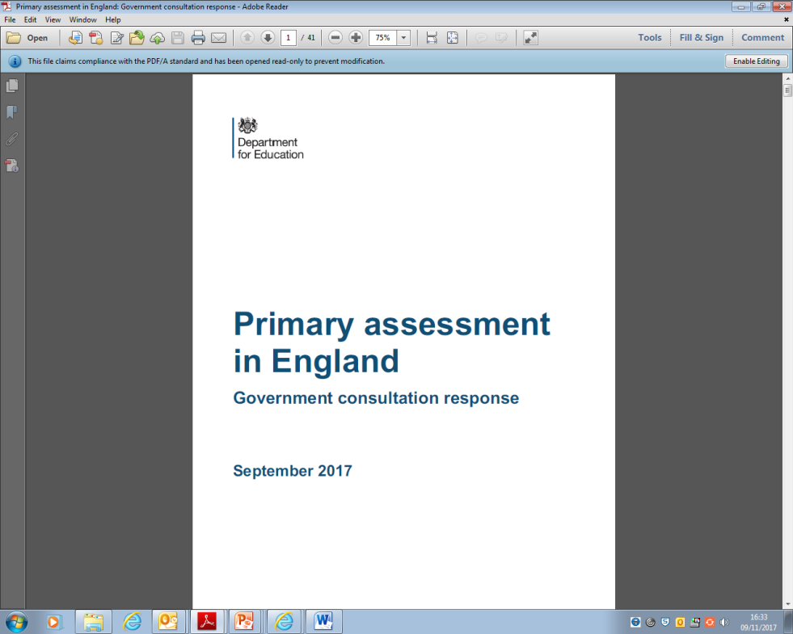


Primary assessment in England (DfE/STA, September 2017)
The DfE has published the government’s response to the ‘Primary assessment in England’ consultation.
Alongside this, the STA has also published teacher assessment (TA) frameworks for key stage 1 and key stage 2 for use in 2018 and updated the interim pre-key stage standards for writing for key stage1 and key stage 2 to align with changes made to the TA frameworks.
The government has responded also to the parallel consultation on the recommendations of the Rochford Review (October 2016).

Slide 70
Revise ELGs to ‘make them clearer and align them more closely with teaching in KS1’;
Introduce YR baseline ‘to act as the start point for measuring progress’ (Autumn 2020) … therefore, new KS2 progress measures (2027);
Remove statutory KS1 TA ‘once the reception baseline is fully established’ (2023);
Introduce times tables check at the end of Y4 (2020);
Remove requirement for end of KS2 statutory TA in reading and mathematics (2019);
Improve KS1/KS2 writing TA 'by giving teachers greater scope to use their professional judgement when assessing pupils (2018);
‘Improve the statutory assessment of pupils working below the standard of national curriculum tests by extending the interim pre-key stage standards to cover all pupils engaged in subject specific learning … ’

Slide 71
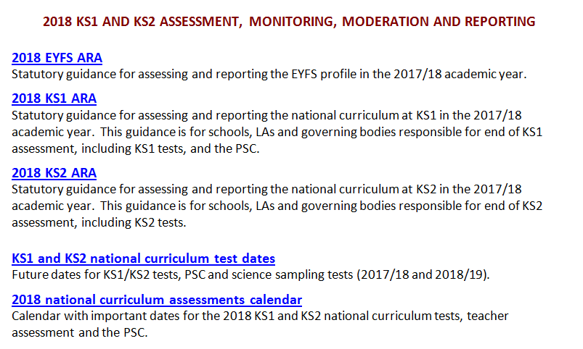

Slide 72


Slide 73
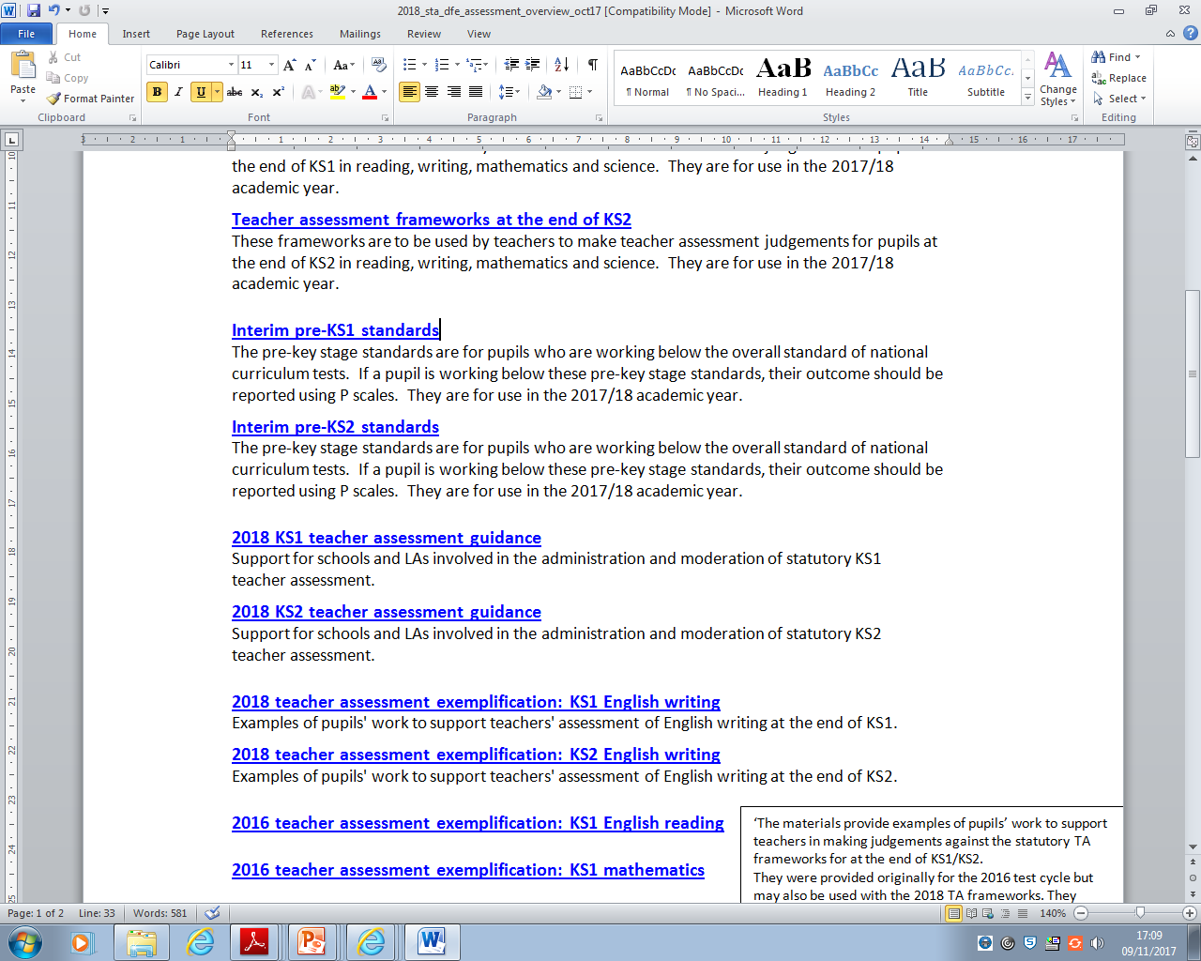



Slide 74

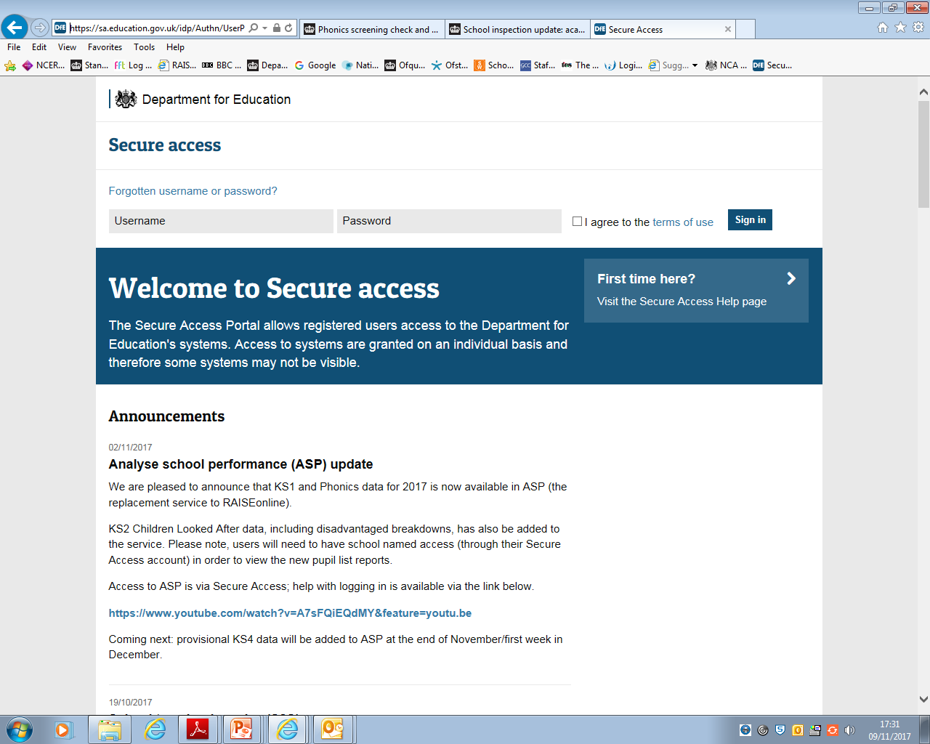
Analyse School Performance (ASP) and Inspection Data Summary Report (IDSR)
The replacement for RAISEonline is a web-based system called Analyse School Performance (ASP).
The IDSR replaces the inspection dashboard. ‘The IDSR includes context pages, showing pupil characteristics, year group data and prior attainment. It includes a front page showing an overview of the data, and areas to investigate .’

Slide 75

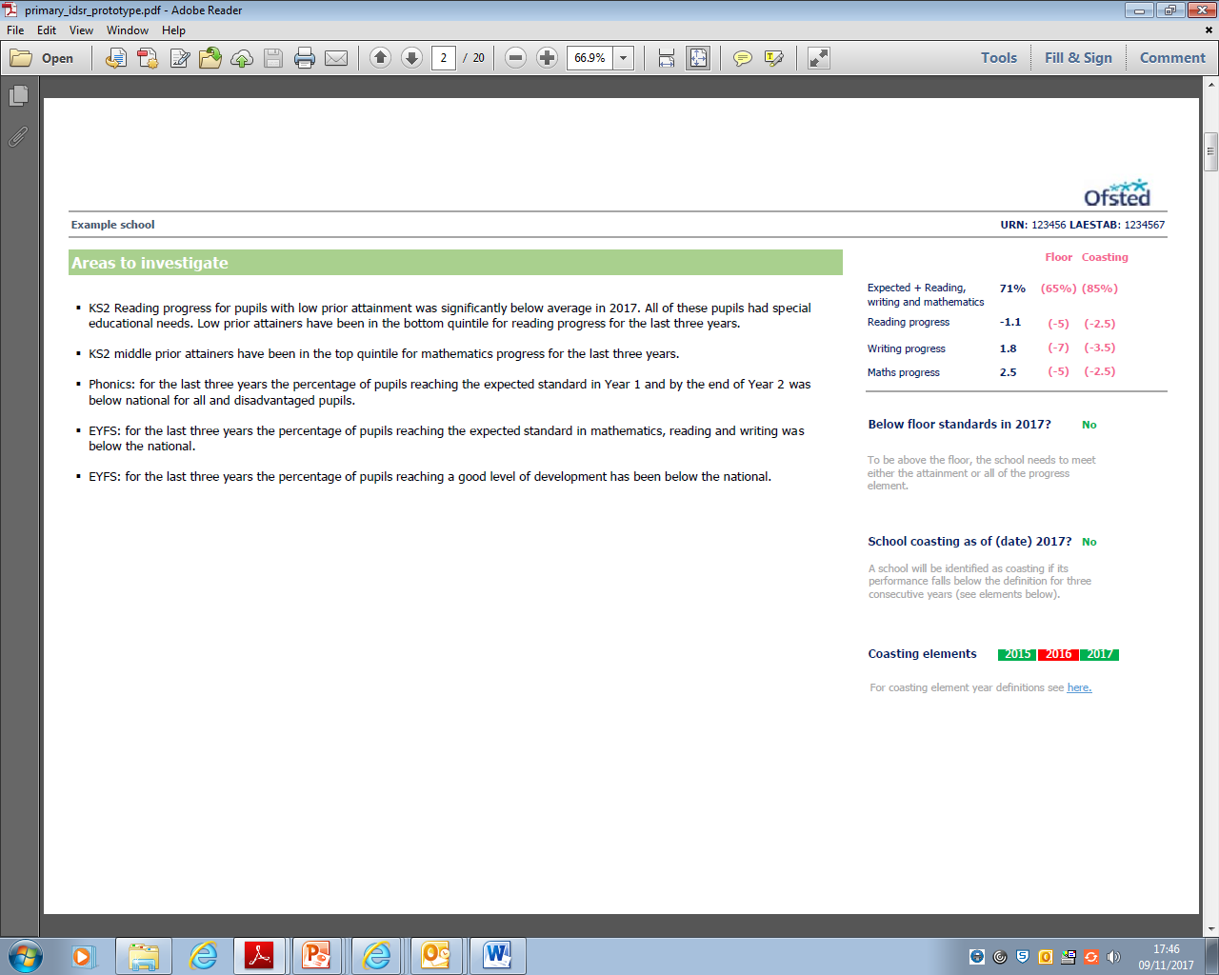
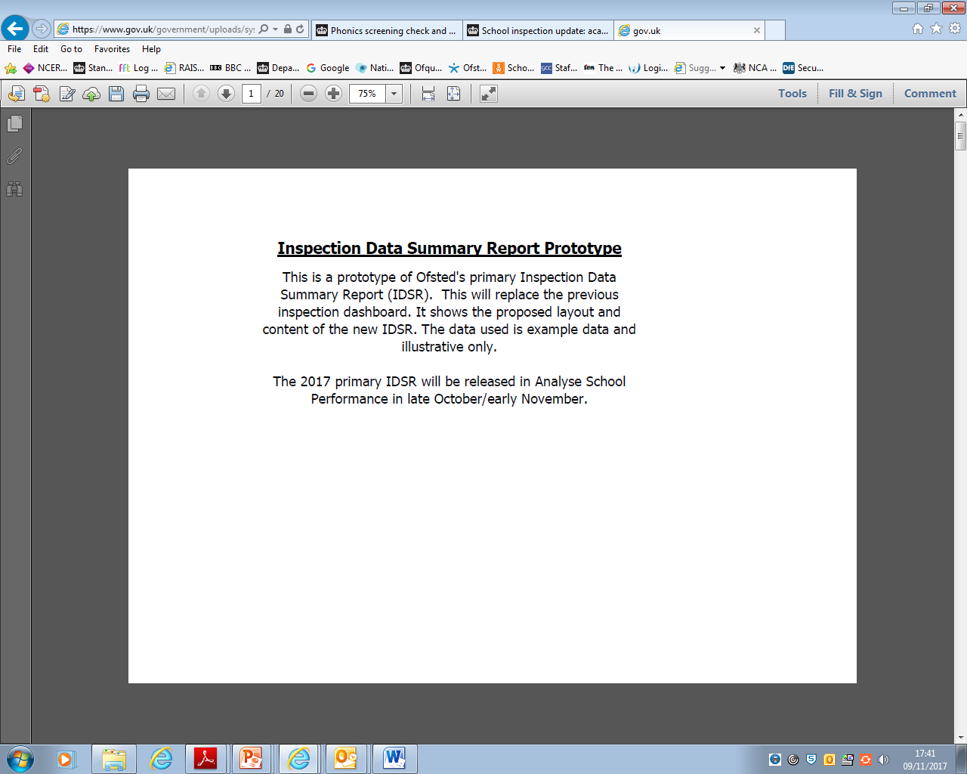
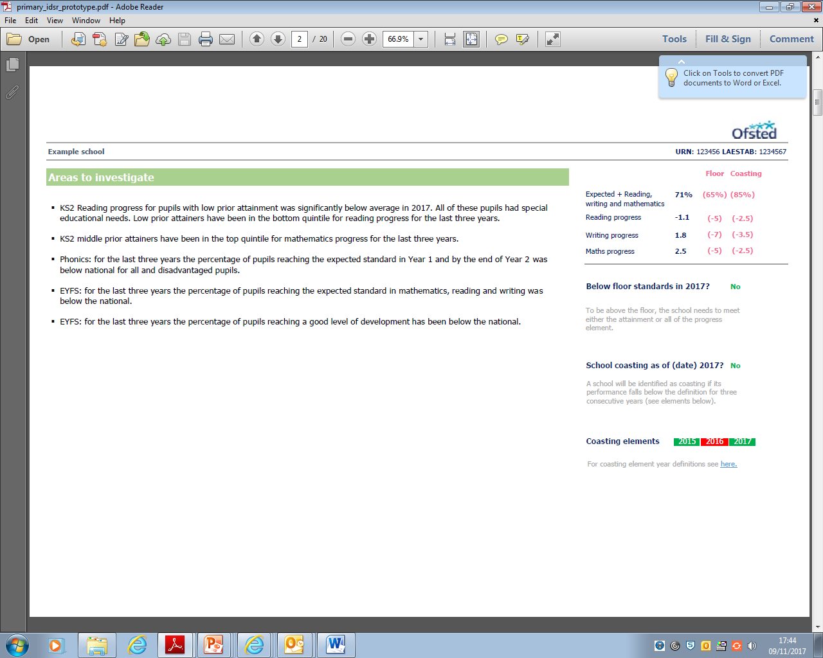

Slide 76


November 2017:
Ofsted has provided documents offering guidance on how to interpret the new IDSR:
an overview of data in the IDSR and information to assist in interpreting charts;
details on how the ‘Areas to investigate’ are generated.

